Slide 1

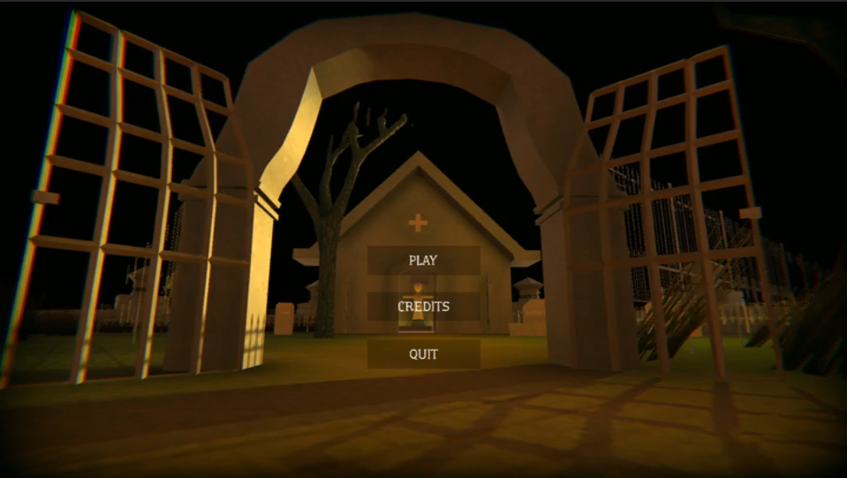
The Silent Manor
Cenker Cennet – Code / Programming
Emre Ozan – Design and Story
Hamit Akbaş – 3D
Gökdeniz Çetin – 2D / 3D
Mert Ünlü – Music / Audio

Slide 2
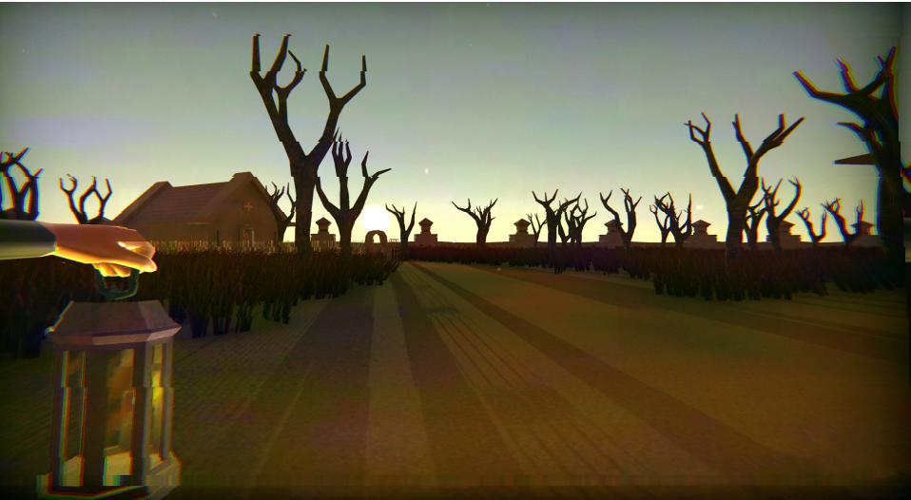
Game Features
Game Type:
High Tension / Adventure
Camera View:
FPP (First Person Perspective)
Game Build:
3D

Slide 3
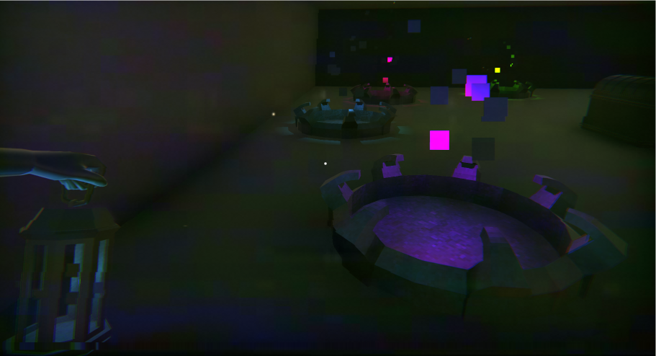
Story
Player is an Investigator
He is hired to find a lost woman
He came to the Manor which the lost woman last seen for investigation
He learns hidden secrets and solves the crime
He escapes the Cursed Place

Slide 4
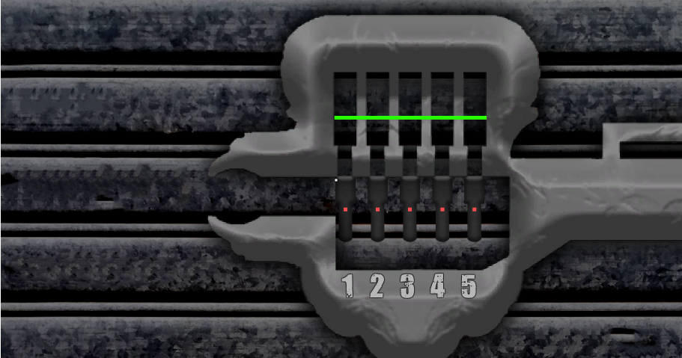
Mini Puzzles
The Player can solve these puzzles with
in game evidences and eye-coordination skills

Slide 5
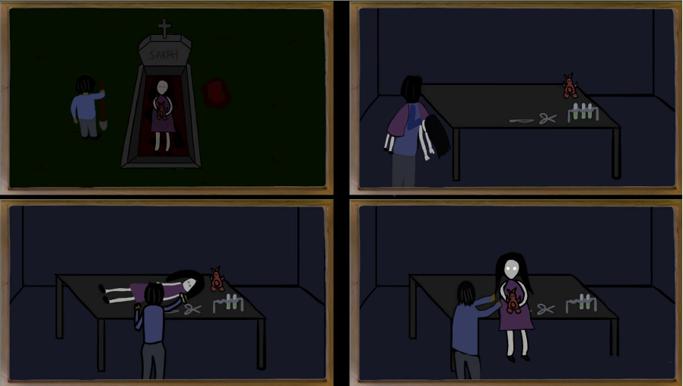
Cutscenes
The Silent Manor game, generally tells the story with cutscenes when the player interacts with highlighted items

Slide 6
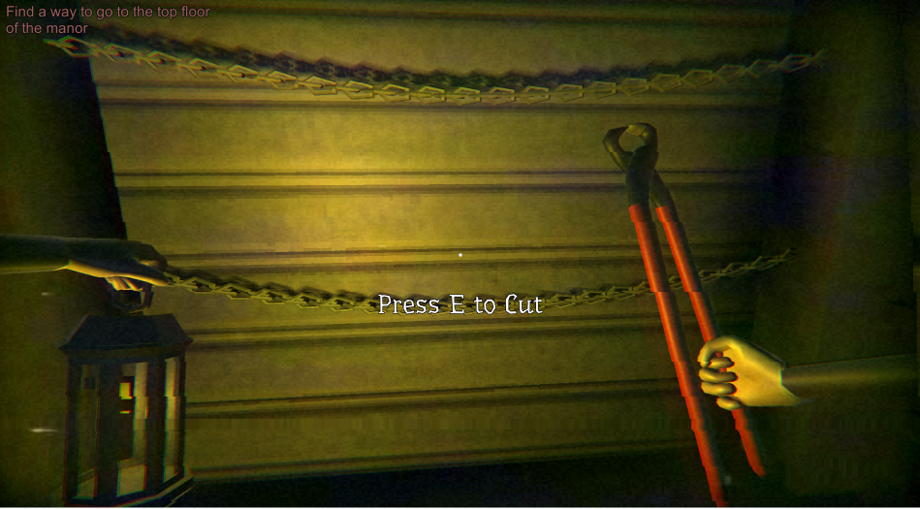
Interactions
Player can interact with objects to achieve / discover new places

Slide 7
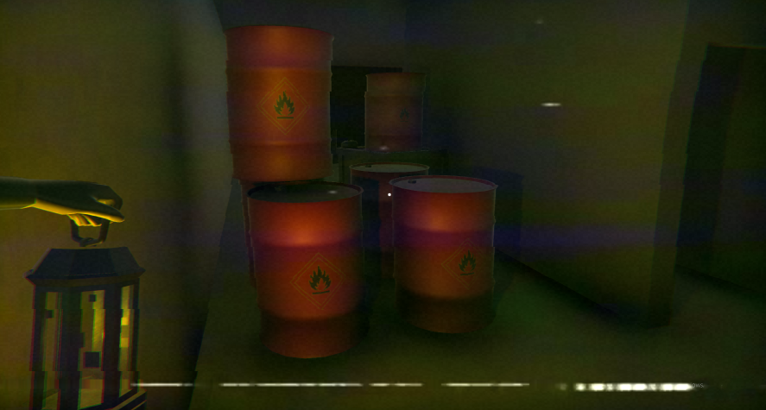
Objective
Collecting clues to solve the Mystery
Escaping from the area after the investigation
Solving mini puzzles to reach locked/hidden places and discover the hidden secrets
Player must have escaped from the area before Dawn

Slide 8
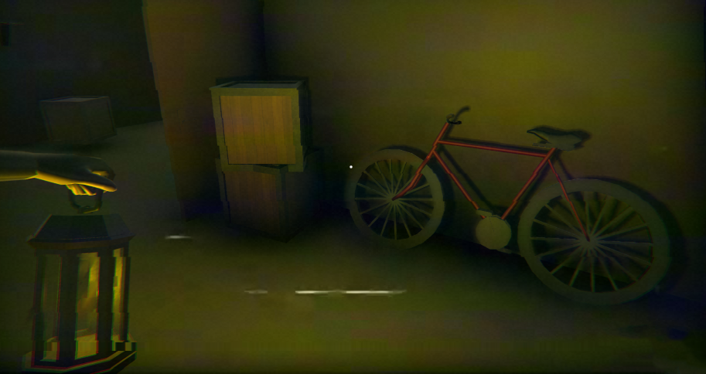
Mechanics / Controls
Space: Jump
Shift: Run
W-A-S-D: Movement
E: Interact with an object
Space: Unlock things
F: Open / Close hand lamp
Also Enter: Skip Cutscene

Slide 9
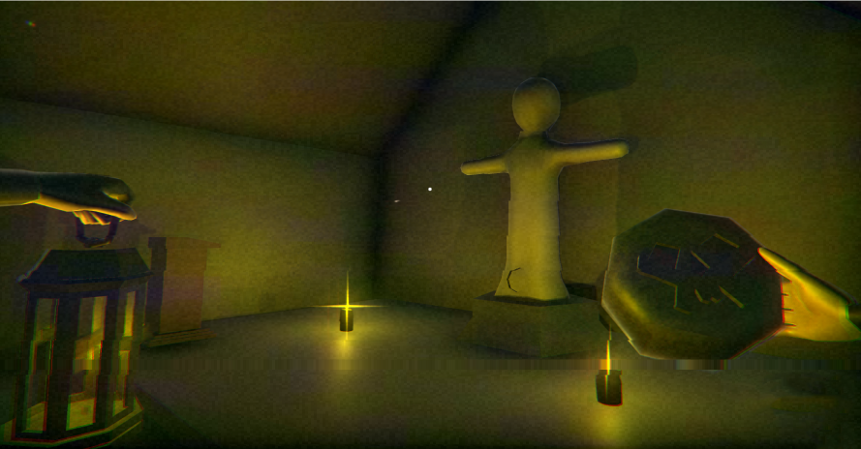
Thanks For Listening

